Slide 1
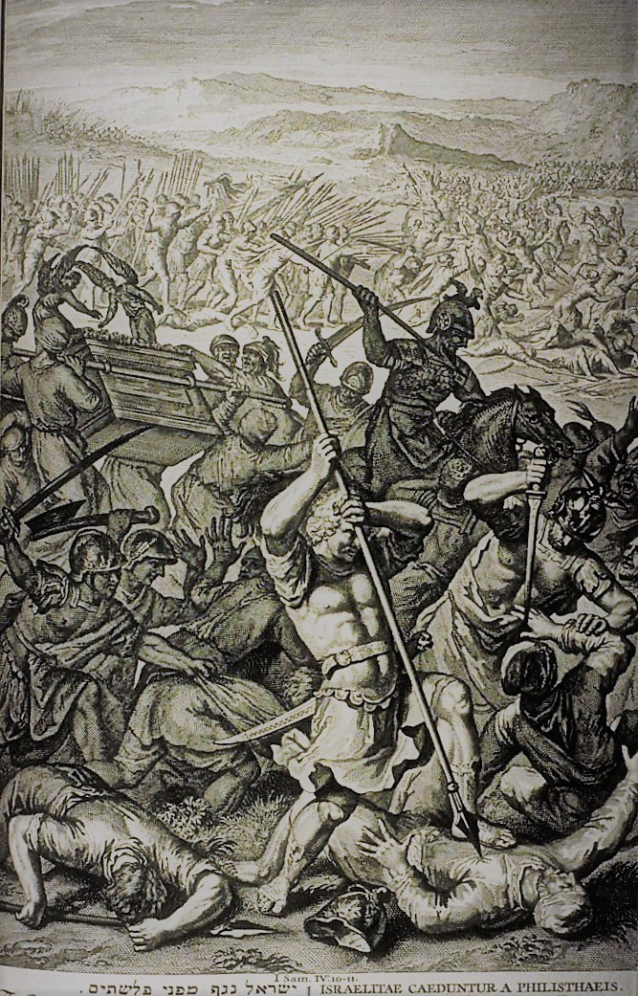
The Danger of Doing What Seems Right in Your Own Eyes

Slide 2
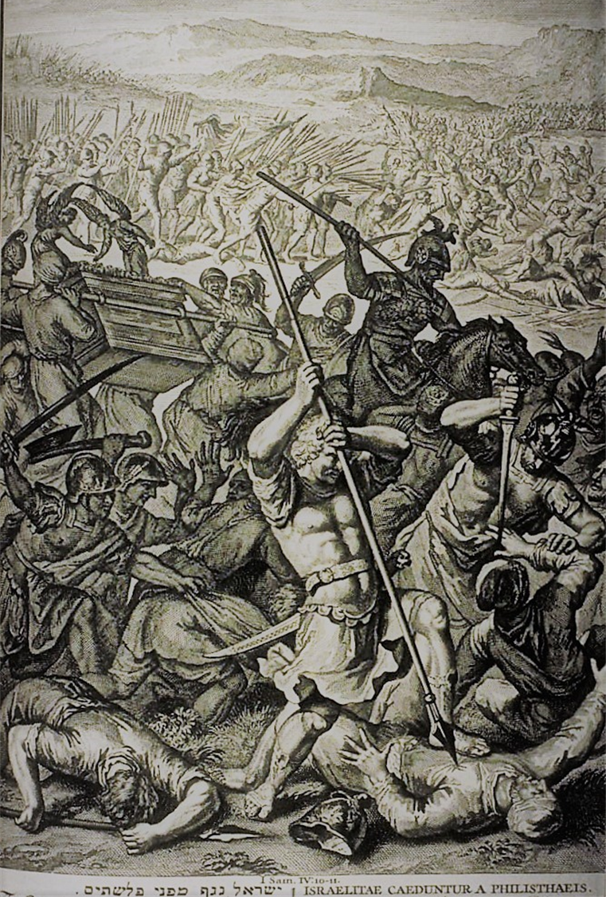
Leads to disaster.
A great slaughter. 34,000 dead. Vs 2,10
The ark of God was taken. Vs 11
The ark was connected to the Lord’s dwelling place.

Slide 3
Revelation 11:19 And the temple of God was opened in heaven, and there was seen in his temple the ark of his testament: and there were lightnings, and voices, and thunderings, and an earthquake, and great hail.

Slide 4
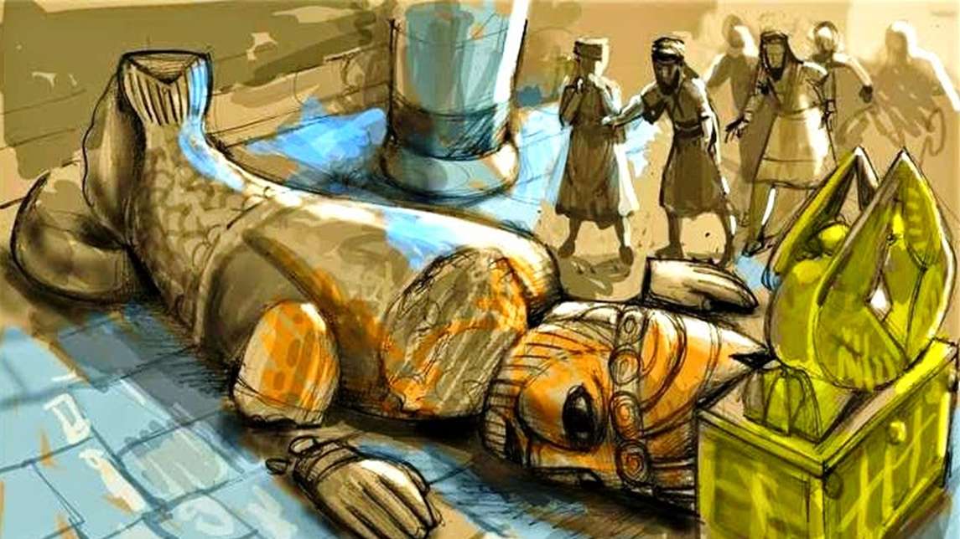

Slide 5
Leviticus 10:1-2 And Nadab and Abihu, the sons of Aaron, took either of them his censer, and put fire therein, and put incense thereon, and offered strange fire before the LORD, which he commanded them not. 2 And there went out fire from the LORD, and devoured them, and they died before the LORD.

Slide 6
Eli’s sons, Hophni and Phinehas were slain. Vs 11
Their sin “found them out.”
The problem: They didn’t just die, they took 34000 with them.
There is ALWAYS fallout when elders sin. They take others down with them.

Slide 7
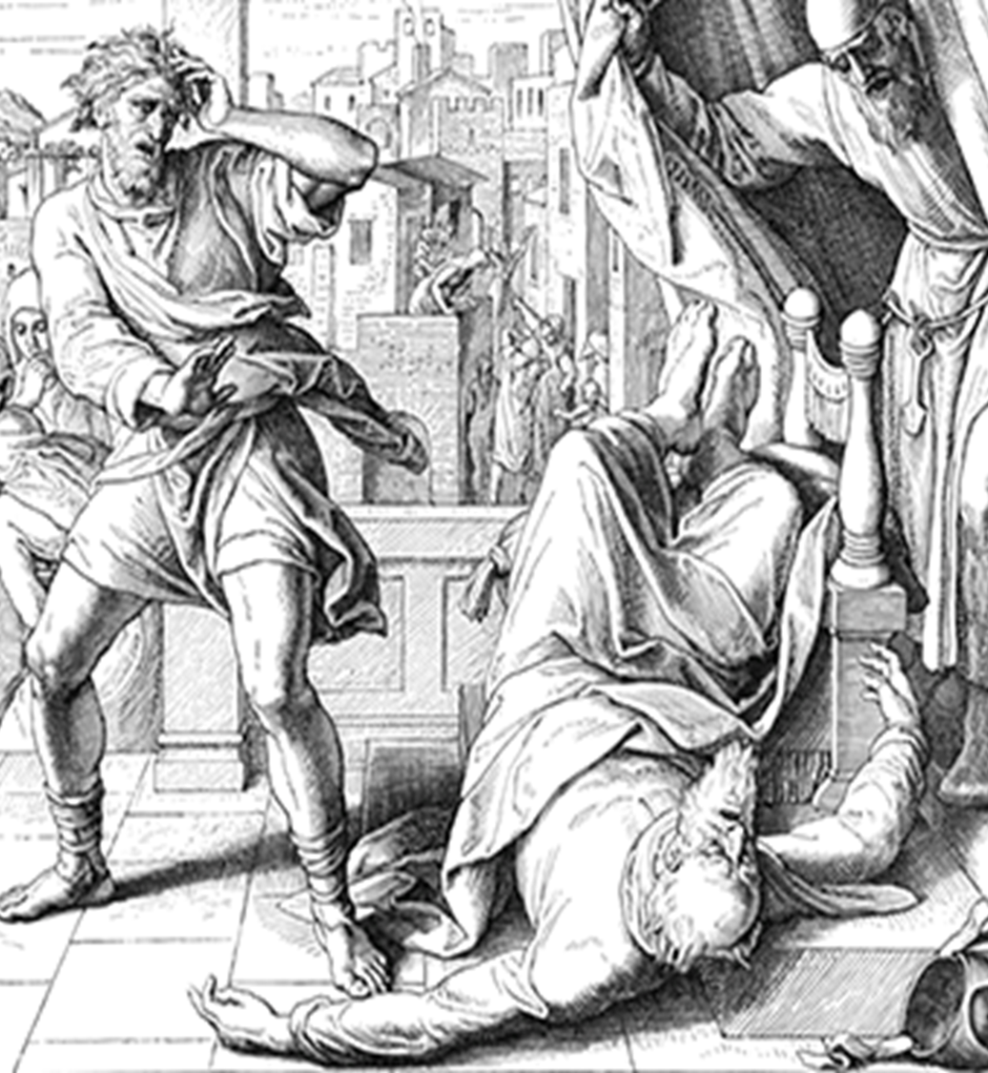
The high priest died. Vs 12-18
Eli’s agony.
Eli’s accident.
  Heart attack?
  Why? Eli was responsible for
  the catastrophe, notice “he had
  judged Israel forty years.”
  Why? Remember Gal 6, Eli became
  fat (2:29, 4:18) from his son’s theft.
  Prophecy fulfilled!

Slide 8
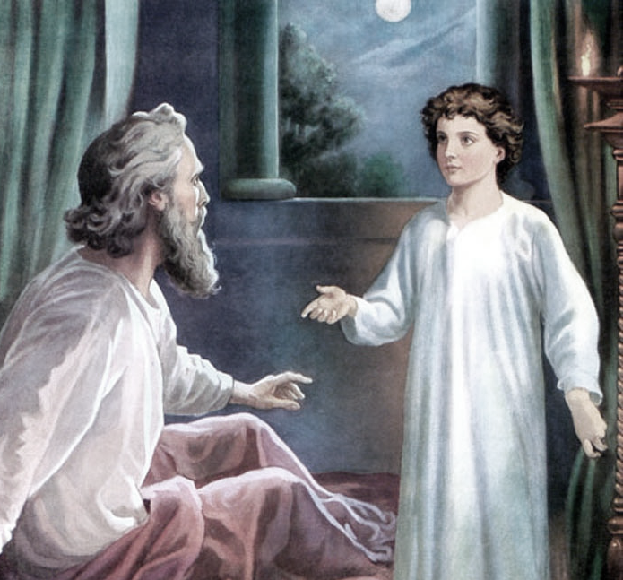
Israel will need a new leader - Samuel.

Slide 9

The Glory of God Departed
Terrible news brings travail.
Terrible news brings a terrible
name.
Phinehas’ wife has more spiritual awareness than her husband, brother in law and father in law!

Slide 10
Exodus 40:34-35 Then a cloud covered the tent of the congregation, and the glory of the Lord filled the tabernacle. 35 And Moses was not able to enter into the tent of the congregation, because the cloud abode thereon, and the glory of the Lord filled the tabernacle.

Slide 11
Leviticus 16:2 And the Lord said unto Moses, Speak unto Aaron thy brother, that he come not at all times into the holy place within the vail before the mercy seat, which is upon the ark; that he die not: for I will appear in the cloud upon the mercy seat.

Slide 12
Exodus 25:22 And there I will meet with thee, and I will commune with thee from above the mercy seat, from between the two cherubims which are upon the ark of the testimony, of all things which I will give thee in commandment unto the children of Israel.

Slide 13
Numbers 7:89 And when Moses was gone into the tabernacle of the congregation to speak with him, then he heard the voice of one speaking unto him from off the mercy seat that was upon the ark of testimony, from between the two cherubims: and he spake unto him.

Slide 14
James 4:8 Draw nigh to God, and he will draw nigh to you. Cleanse your hands, ye sinners; and purify your hearts, ye double minded.
2 Chronicles 7:14 If my people, which are called by my name, shall humble themselves, and pray, and seek my face, and turn from their wicked ways; then will I hear from heaven, and will forgive their sin, and will heal their land.

Slide 15
The Glory of God is Departed

